Slide 1
QUALITY ACADEMIC DELIVERY
VITAL INDEX IN
WORLD CLASS RANKING
WORLD CLASS
By
AREMU CHARITY
Dean, SPS

Slide 2
OVERVIEW
a.
b.
c.
d.
e.
f.
g.
f.
Seven ingredients

Slide 3
Overview
LMU vision
Academic quality (definitions)
World class indicators and models
Academic quality pivots:
Learning environments;
Modules, Curriculum
e. Teaching and administration
f. Ethics/Etiqutte
g. Expectations/ way forward
Conclusions
Feedback mechanism

Slide 4
To be a leading world class university, by spearheading an agrarian revolution on the African continent through the exploration of hidden treasures in mother-earth thereby restoring the dignity of the black race.

Slide 5
“Emphacy wakes
a sleeping mind, sets an awake mind to walk
and sets a walking mind to flight”…. John drakes
Quotes

Slide 6
A LEADING
Strength
Landmark VISION QUEST
Faculty
Staff
Students

Slide 7
_{ReC I T E}
Landmark
Loud; clear; palpable

Slide 8
University of Ibadan
Covenant University
UI
CU
M O D E L S
To be a leading World-Class Christian Mission University, committed to raising a new generation of leaders in all fields of Human endeavour.
To be a world-class institution for academic excellence geared towards meeting societal needs

Slide 9
Oxford
is to be recognized as delivering world class facilities that support world class research, teaching and learning

Slide 10
RANKING BODIES

Slide 12
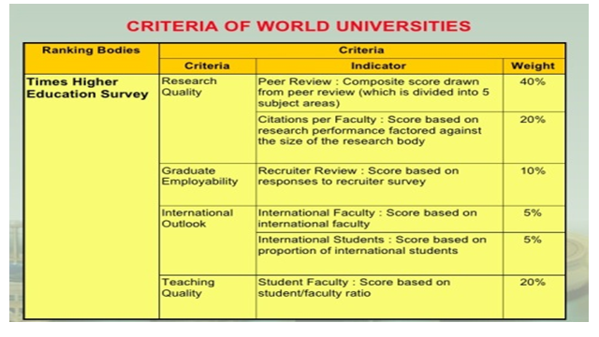

Slide 13
TEACHING
Reputation survey 10%
Faculty : Student ratio 6%
Doctorate : Bachelor’s ratio 3%
Doctorates-awarded (academic-staff ratio) 8%
Institutional income 3%
30%

Slide 14
2018 Rank | 2016-2017 | Institution | Region/country
1 | 1 | University of Oxford | U.K
2 | 4 | University of Cambridge | U.K
-3 | 2 | California Inst. Of Tech | U.S
-3 | 3 | Stanford University | U.S
5 | 5 | Massachusetts Inst. Of Tech | U.S
6 | 6 | Harvard University | U.S
7 | 7 | Princeton University | U.S
8 | 8 | Imperial College London | U.K
9 | -10 | University of Chicago | U.S
-10 | 9 | ETH-Zurith Swiss Fed Inst. Of Tech | Switzerland
-10 | 13 | University of Pennsylvania | U.S

Slide 15
Focus

Slide 16
QUALITY ACADEMIC DELIVERY: A VITAL INDEX IN WORLD CLASS RANKING…..
WORLD CLASS LIST

Slide 17
High performance that succeeds in satisfying stakeholders expectations by meeting or exceeding the needs
Quality ?
journey
process
search towards meeting the changing needs of an organization and striving to meet the needs
Demands which eventually becomes a culture
….Steve Spangehi
http://www.ncacasi.org/
Academic
Quality

Slide 18
Academic quality:
Learning
Teaching,
all operations
Procedure in service delivery
Quality for
Palpable results

Slide 19
Academic quality: models
Harvard,
Massachusetts,
California Institute of Technology,
Oxford
Modern Teaching and classroom management
Internal quality assurance/checks
Centre for academic quality assurance….. A centre with ETLF

Slide 20
Teaching/ learning Framework
Work oriented learning,
Entrepreneurship training
Innovative curriculum
Investment in accessible physical and digital resources
Student participation platforms (personalised/group work)…studynet

Slide 21
MODERN LEARNING ENVIRONMENT
Any technology that supports learning.
B_{ring} E_{ngage} Y_{our} O_{wn} D_{evice}
computers (desktops, laptops, and tablets),
interactive whiteboards,
smart screens,
i phones
Conferencing
Ownership and power shift to the student.

Slide 22
Princeton
Studynet
Standard Learning Environments

Slide 23
MODERN LEARNING ENVIRONMENT
Oxford University classroom
Has a standing committee
Develop teaching schemes
Plan,
Deliver and
Evaluate
both University tutors and school-based colleagues working alongside one another.

Slide 25
“In today’s modern classroom, schools in US are swapping whiteboards, copybooks and textbooks for new, advanced alternatives such as tablet computers and eBooks, interactive screens etc.
Some teachers may downplay the importance of computers in the classroom, but it is undoubtedly the way of the future. Students want to utilize computers and devices more in the classroom: whether it be for watching informative video clips or for fun, interactive lessons and many more.
This trend is set to continue as classrooms increasingly seek to integrate technology into their day to day learning”
……………………………………………………By USA based GDK network system 2018

Slide 26
“With tablet adoption , interactive screen etc, in classrooms on the rise, it is important that infrastructure follows suit. There is demand for better, faster Wi-Fi, meaning better routers, and according to the US Department of Education, the adoption of technology such as tablets can even mean more motivated students”………………… By USA based GDK network system 2018

Slide 27
MODERN LEARNING ENVIRONMENT
Grey areas
Thoughtfulness
Effectiveness
Involving
Modern technology deployment
24/7 internet
Regular staff development
Smart classroom
Oxford

Slide 28
A working guide to the teacher/faculty
Facilitates teaching and learning
Ensures promptly delivery
Provides direction
Appraisal of both faculty and student a document,
A course in PDF, Powerpoint, Video, etc
Academic quality:
Module:
Deliverable
Impactful

Slide 29
Module framework

Slide 30
Module framework
1. Author(s):
Aremu, C.O.PhD; Olayanju, A.T, PhD
2. Aims and objectives
The aims of this paper are to:
a. Provide the basics in academic quality as a vital demand for world class university listing
b. Create a stakeholder mentality using academic quality as a working tool
c. Enable participants to identify their role in the delivery of academic quality
3. Learning outcomes
After studying this paper, participants will be able to:
1. Identify the place of teaching and enabling learning environment in a world class university setting
2. Apply some major guidelines to effective teaching and learning towards LMU quest for world class enlistment

Slide 31
3. Identify and apply standard ethics and etiquette in all academic meetings/units
4. Contents
. Introduction
Why this presentation
Examples of success stories
5. Teaching and learning methods:
learning and setting ground rules….defines acceptable classroom behaviour
preparing for teaching
facilitating the integration of knowledge, skills and attitudes …videos, pictures, field tour etc
teaching and learning in groups

Slide 32
seminars and tutorials
computer based teaching and learning – information technology….links…www.
6. Topics:
Week 1;2;3;4;5;6;7;8;9;………15
6b. descriptions of topics using pictures, links, video clips, etc
6c Assignments, quiz/tests etc
7. References, further reading and useful links
8. Acknowledgements
Thanks must go to colleagues who have contributed towards module writing

Slide 33
Lecture
note
Reading out is boring to students
More time spent
Explanation not in details
Students miss out key points
Stressful
Topic details from the modules
writing it out in advance clarifies the what and how, timely delivery

Slide 34
Lecture note : Harvard model
“The lecture notes will be uploaded here shortly after each lecture”.
Lecture 1 David Mond and David Elmes
Lecture 2 Michael Pounds
Lecture 3 Michael Pounds
Lecture 4 Andrew Levan
Lecture 5 David Mond and David Elmes
Lecture 6 Alastair Smith, Ben Richardson powerpoint and Ben Richardson Lecture Notes
Lecture 7 David Elmes
Lecture 8 Alice Mah and David Mond

Slide 35
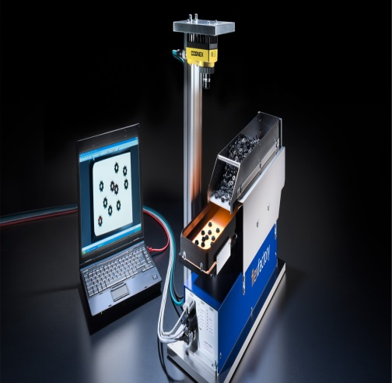
Lecture Delivery : Performance Index
Clarity of instructional objectives
Quality of instruction
Teacher demonstration
Student participation
Guided practice
Differential reinforcement
Meta-cognitive strategies
Group tutorials
Corrective feedback
Cumulative review
Source: US GDK series

Slide 36
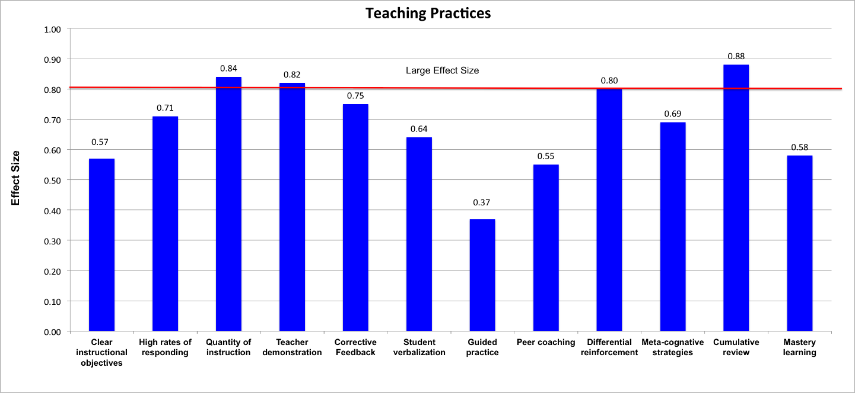
Lecture delivery: Performance Index
Source: US GDK series

Slide 37
Model Classroom
Voice
Connected learning
Choice
Time for reflection
Self Assessment
Critical thinking
Problem solving
Innovation
Learner
focused

Slide 38
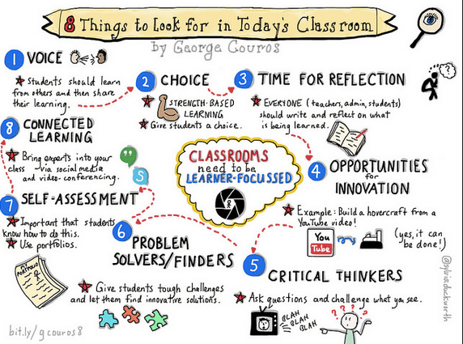
A TYPICAL WORLD CLASS CLASSROOM

Slide 39
Academic Quality:
The place of
Curriculum
Demand Driven Curriculum (DDC):
Universities are rarely structured to facilitate learning and when they are, it is often done in a limited way. DDC provides a
theory and practice of learning and how universities can improve their quality and competence.
Our strategies include a curriculum design and timetable structure that challenges the very silo curriculum areas and subjects often driven by universities
…… J.Browden and Ference Marton

Slide 40
Academic Quality:
The place of
Curriculum
Effective and impactful curriculum should provide
integrated modules alongside more traditional subject modules
opportunities for significant directives on passion driven projects.
Students and teachers should be encouraged to work collaboratively to share and move between spaces /locations in pursuit of demand driven curriculum

Slide 41
Academic quality:
Monitoring and
evaluation process
For quality and timely delivery of academic processes
Establishment and preservation of active academic culture is vital
Both faculty and students are monitored and evaluated….Tests/Quiz/Examination/ appraisals etc
Quality Assurance Agency (QAA)…. A body that play oversight on all academic processes
Constant checks and review

Slide 42
Academic Quality models: Landmark/Nigeria
NUC Benchmark for minimum academic standard (BMAS)
Decree act of no. 48 0f 1988 empowered NUC to lay down minimum standards for programs taught in Nigerian Universities

Slide 43
Harvard
Academic Quality
models:
Quality Assurance/Quality Improvement (QA/QI) agency
investigate institutional compliance with federal and state regulations governing teaching and research.
provide support for education and study management tools, and best practices
Make recommendations that go above and beyond mere compliance,
emphasis on improving efficiency.

Slide 44
Quality Assurance Agency (QAA).
Established in 1997 to safeguard the public interest in:
sound standards of higher education qualifications
continuous improvement in the management of the quality of higher education. Has 12 frameworks
Quality assurance framework / Teaching quality:
http://www.hefce.ac.uk/pubs/hefce/2006/06_45

Slide 45
QAH
ADMISSIONS
2. INDUCTION
3. COURSE DESIGN, APPROVAL, MONITORING AND REVIEW
5. STUDENT FEEDBACK
6. STUDENT COMPLAINTS AND APPEALS
7. STATISTICAL INFORMATION
8. EXTERNAL INPUT
9. QUALITY ENHANCEMENT IN LEARNING AND TEACHING
10. MONITORING OF TEACHING
11. POSTGRADUATE RESEARCH DEGREES
12. COLLABORATIVE PROVISION AND PLACEMENT LEARNING
ANNEXE A: UNDERGRADUATE ADMISSIONS – COMMON FRAMEWORK
ANNEXE B: GRADUATE ADMISSIONS – POLICY AND GUIDANCE
ANNEXE C: EXAMINATIONS – QAA PRECEPTS
ANNEXE D: PRECEPTS FROM QAA CODE OF PRACTICE SECTION
‘EXTERNAL EXAMINING’

Slide 46
Princeton University 5:1
California Institute of tech 3 :1
Harvard 7:1
Yale 6 :1
‘’’’’’’’’’’’’’’’’’’’’’’’’’’’’’’’’’’’’’’’’’’’’’’’’’’’’’’’’’’’’’’’’’’’’’
Soka Univ
Pomona College,
Univ. of Richmond
Studnt :Faculty ratio vary across the world, averagelly, 18 :1 is common in US
Student :
faculty
8 :1

Slide 47
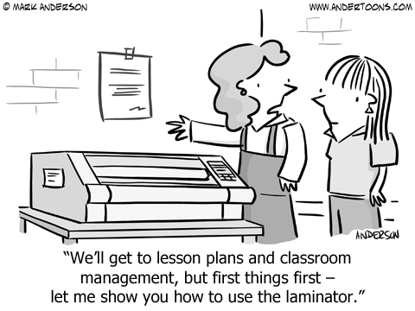
Academic Quality
mentorship
A mentor:
Willing to share
Demonstrates positive attitude at all turns
Embraces power of goal setting
A model to follow…records of success,

Slide 48
Academic Quality:
LEADERSHIP AND
SERVICE
A Leader
Knowledgeable
Reliable
Proactive
Prompt
Available
Not fault finding
Large hearted
Feedbacks
Role model

Slide 49
Academic Quality
Meetings
Information, instructions and directions for the vision pursuit.
Attendance,
Promptness
Contributions/participations
Feedback to unit members essential
Statutory /ad-hoc

Slide 50
Ethics and Etiquette
Academic Quality:
“The true value of a human being is determined primarily by how he has attained liberation from the self “
A discipline
good
moral
duty and obligation
Human value ……….…Albert Einsten

Slide 51
Behaving yourself a little better than is absolutely essential … Will Cuppy Formal manners rules in social or professional settings. NOT being SELFISH with expectations

Slide 52
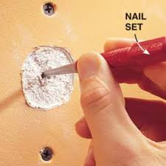
Conduct?
Carriage,
acceptance,
flow,
reactions
performance
comportment
Compliance etc.

Slide 53
Instructions ….. from LU INFO mail… complaince?....8th Jan 2019
Please be informed that all the platforms are ready for Course-Lecturer Upload Assignments.
We admonish all Departments and Programmes to kindly forward the list of their respective Uploaders (Lecture, Moodle and Result) to CSIS for immediate assignment.
Kindly forward the comprehensive list to sad@lmu.edu.ng, and copy the following emails: igbekele.emmanuel@lmu.edu.ng, oshodi.akinwale@lmu.edu.ng, ojo.samuel@lmu.edu.ng, samuel.olawepo@lmu.edu.ng. In the case of any further challenge or change in uploader for a Course, pertinent CSIS Staff should be contacted promptly;
Result Uploaders: (sad@lmu.edu.ng (4049) or igbekele.emmanuel@lmu.edu.ng(4244) or oshodi.akinwale@lmu.edu.ng(4246))
E-learning Moodle: (ojo.samuel@lmu.edu.ng(4824)) Lecture Attendance Uploaders: (samuel.olawepo@lmu.edu.ng(4243))

Slide 54
Compliance….Instructions
To | HODs, Academic Departments
From | Director, Academic Planning
Subject | Omega Semester Students’ Course Registration
Date | 16 January, 2019
1.55pm
Landmark University, Omu-Aran
Office of the Vice chancellor
directorate of academic planning
Internal Memo
Dominion Greetings.
I write to remind our esteemed students’ Level Advisers in the ongoing Omega semester of 2018/2019 academic session that;
Approval/Non-approval of Omega Semester course registration as commenced on Monday 7th January is expected to be in full implementation.

Slide 55
How to be of good conduct

Slide 56
To invigorate and reinvigorate efforts in the vision drive;
A vital check list amongst world class Universities
Outstanding participants can be encouraged by:
Awards
Letter of commendations
List of honours
Certificates of honours
Reward system

Slide 57
Way forward

Slide 58
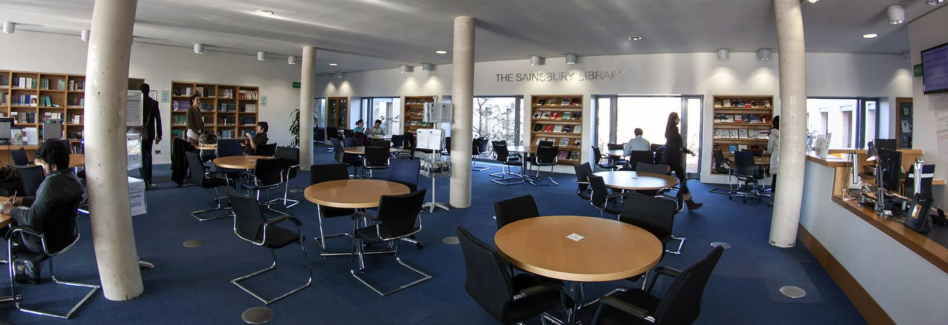
Colleges/units
Colleges to institute regular colloquium to discuss, best practices….teaching, learning, collaborations etc.
Job ethics/etiquette /policies
Develop College/unit research site(s)… FOCUS -community impact
Encourage/stimulate innovations by students
WAY forward
Oxford

Slide 59
Have a central research meeting ( idea simulation)
Design an internal and external forum for idea simulation and collaborative research
Identify key and related outfits......research and production to give speed to our quest for relevance.
Colleges/units
OFFICE OF
WAY forward
POSTGRADUATE
RESEARCH

Slide 60
Attract international/industrial partnership
Regular update on all operational strategies….statutory/adhoc meetings
Ensure compliance to rules/regulations of the university
Institute Centre for academic quality assurance …..Oxford model…QAhandbook
Role of Management

Slide 61
Teaching (Learning Environment)
a. Improve Teaching Facilities
b. Exhaustive review of Curricula
c. Reputation in Learning…quality instructions, teaching, modules, notes etc. = reputation
Re-invigorate Staff Development /welfare Programme
Recruit Masters’ degree holders: to improve ratio of doctorate holders.
Improve Staff/Student ratio.
Role of Management

Slide 62
Role of Management
Engage the existing Strategic Plan
explicit route to excellence in teaching, learning and other academic quality checks.

Slide 63
Role of Management
Attract quality manpower at all level
Reduce attrition rate
Create cosy learning environment
Create /maintain standard and attractive teaching and learning ambiance
Encourage faculty ranking in scienciometric data base
Intensive Subscription drive (from within)

Slide 64
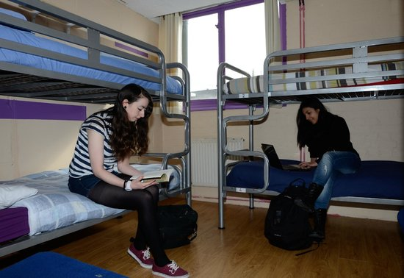
Subscription
Oxford model
Student welfare:
Comfort
Accommodation
Counselling
Availability
Feeding
Hostel

Slide 65
Subscription
Oxford model
Cafeteria

Slide 66
VISIBILITY: Graduates whose names are published in quality journals;
EMPLOYMENT: Graduates who can launch start –up companies based on their experience
INNOVATIONS: Faculty , staff and students with recorded patents and owning Intellectual properties credited in their names as copyright owners;
World class stakeholders
World Class Landmark: World class enlistment
Expectations

Slide 67
Quotes
“A center of excellence (CoE)
is a team, a shared facility or an entity that provides leadership, best practices, research, support
and/or training for a focus area”.
Professor Margaret House,
Vice Chancellor, Leeds
Trinity University

Slide 68
…..“We will continue to move to an
increasingly Harvard led faculty system
which recruits enough great
Faculty in every part of the
County and the world, so that we control schools and leaders and determine which
teachers are recruited and how
they are trained”. ……
Professor Margaret House,
Vice Chancellor, Leeds
Trinity University
Quotes

Slide 69
Stakeholders
Own It
Embrace it
Run with it
10: 2028

Slide 71
Thank you
Obrigado
Grazie
Dankie
Feedbacks
aremu.charity@lmu.edu.ng
Lmu executive advance , Aug. 2018

